Slide 1
SOFTWARE ENGINEERING AND PROJECT MANAGEMENT
PHASES OF RISK MANAGEMENT

Slide 2
CONTENTS
What is a risk?
What is risk management ?
What are the principles by which we can manage risks?
Phases of risk management?

Slide 3
What is Risk?
Risks are potential problems that may affect successful completion of a software project.
Risks involve uncertainty and potential losses.
Risk analysis and management are intended to help a software team understand and manage uncertainty during the development process.

Slide 4
Risk Management
The Risks we encounter in a project should be resolved so that we are able to deliver the desired project to the customer.
The project should be managed in such a way that the risks don’t affect the project in a big way.
The art of managing of the risks effectively so that the WIN-WIN situation and friendly relationship is established between the team and the customer is called Risk Management.
By using various paradigms, principles we can manage the risks

Slide 5
The Principles of Risk Management
Global Perspective: In this we look at the larger system definitions, design and implementation. We look at the opportunity and the impact the risk is going to have .
Forward Looking View: Looking at the possible uncertainties that might creep up. We also think for the possible solutions for those risks that might occur in the future.
Open Communication: This is to enable the free flow of communication between in the customers and the team members so that they have clarity about the risks.
Integrated management: In this phase risk management is made an integral part of project management.
Continous process :In this phase the risks are tracked continuously throughout the risk management paradigm.

Slide 6
Phases of Risk Management
Risk Identification
Risk Analysis

Slide 7
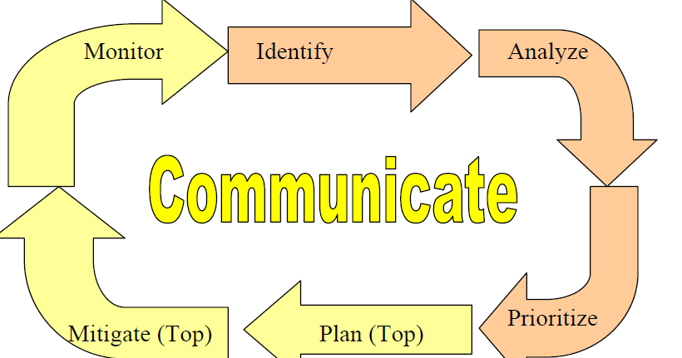
PHASES OF RISK MANAGEMENT

Slide 8
Risk identification
the team systematically enumerates as many project risks as possible to make them explicit before they become problems.
There are several ways to look at the kinds of software project risks

Slide 9
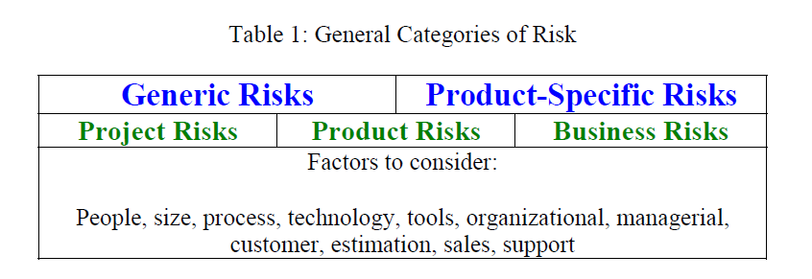

Slide 10
Risk identification
Product-specific risks
the project plan and software statement of scope are examined to identify any special characteristics of the product that may threaten the project plan
Generic risks
are potential threats to every software product
product size
customer characteristics
development environment
technology to be built

Slide 11
Risk Analysis
After risks have been identified and enumerated, the next step is risk analysis.
Through risk analysis, we transform the risks that were identified into decision-making information.
In turn, each risk is considered and a judgment made about the probability and the seriousness of the risk.

Slide 12
Steps in Risk analysis
a) Assess the probability of a loss occurring. Some risks are very likely to occur. Others are very unlikely.
Establish and utilize a scale that reflects the perceived likelihood of a risk.
Establish and utilize a scale that reflects the perceived likelihood ofa risk.
Depending upon the degree of detail desired and/or possible, the scale can be numeric, based on a percentage scale.
b) Assess the impact of the loss if the loss were to occur.
Delineate the consequences of the risk, and estimate the impact of the risk on the project and the product. Similar to
the probability discussion above, the team can choose to assign numerical monetary values to the magnitude of loss

Slide 13
The analyzed risks are organized into a risk table which contains following columns:
Rank is
Risk is the description of the risk itself, preferably stated in CTC format.
Probability is the likelihood of the risk occurring, using either a numeric or categorical scale, as discussed in the last section.
Impact is the magnitude of the loss if the risk were to occur, using either a numeric or a categorical scale.
Rank last week and the number of weeks on list are documented so the team can monitor changes in priority, to determine if actions are being taken that cause changes in the stature of the risk.
Action documents what the team is doing to manage the risk.

Slide 14
Prioritize Risk
After the risks have been organized into a risk table, the team prioritizes the risks by ranking them.
It is too costly and perhaps even unnecessary to take action on every identified risk.
Some of them have a very low impact or a very low probability of occurring – or both.
Through the prioritization process, the team determines which risks it will take action on.

Slide 15
The team sorts the list
The high probability, high impact risks percolate to the top of the table and the low-probability, low impact risks drop to the bottom.
If the team used categorical values for probability
(e.g. very improbable, improbable, probable, or frequent) and/or impact (e.g. negligible, marginal, critical, or catastrophic),
group consensus techniques may need to be used to produce the risk ranking.

Slide 16
If numerical values were given for probability (percentage) and impact (monetary), the risk exposure can be calculated
Risk exposure is calculated as follows (Boehm, 1989):
Risk Exposure (RE) = P × C
where P = probability of occurrence for a risk and C is the impact of the loss to the product should the risk occur.

Slide 17
Plan
After the risks are prioritized, the team, led by the project manager, defines a cut off line.
Only the risks above the line are given further attention.
The activities of this are to plan, mitigate, monitor, and communicate
Risk management plans should be developed for each of the “above the line” prioritized risks so that proactive action can take place.

Slide 18
Following are some examples of the kinds of risk planning actions that can take place:
Information buying.
Perceived risk can be reduced by obtaining more information through investigation.
For example, in a project in which the use of a new technology has created risk, the team can invest some money to learn about the technology.
Contingency plans.
A contingency plan is a plan that describes what to do if certain risks materialize.
By planning ahead with such a plan, you are prepared and have a strategy in place do deal with the issue.

Slide 19
• Risk reduction.
For example, if the team is concerned that the use of a new programming language may cause a schedule delay, the budget might contain a line item entitled “potential schedule” to cover a potential schedule slip.
Because the budget already covers the potential slip, the financial risk to the organization is reduced.
Alternately, the team can plan to employ inspections to reduce the risk of quality problems.

Slide 20
• Risk acceptance.
Sometimes the organization consciously chooses to live with the on sequences of the risk (Hall, 1998) and the results of the potential loss.
In this case, no action is planned.

Slide 21
Mitigate
Related to risk planning, through risk mitigation, the team develops strategies to reduce the possibility or the loss impact of a risk.
Risk mitigation produces a situation in which the risk items are eliminated or otherwise resolved.
These actions are documented in the Action column of the Risk Table

Slide 22
Some examples of risk mitigation strategies:
• Risk avoidance.
When a lose-lose strategy is likely, the team can opt to eliminate the risk
An example of a risk avoidance strategy is the team opting not to develop a product or a particularly risky feature.
• Risk protection.
The organization can buy insurance to cover any financial loss should the risk become a reality.
Alternately, a team can employ fault-tolerance strategies, such as parallel processors, to provide reliability insurance

Slide 23
Risk planning and risk mitigation actions often come with an associated cost.
The team must do a cost/benefit analysis to decide whether the benefits accrued by the risk management steps outweigh the costs associated with implementing them.

Slide 24
Monitor
After risks are identified, analyzed, and prioritized, and actions are established, it is essential that the team regularly monitor the progress of the product and the resolution of the risk items, taking corrective action when necessary.
This monitoring can be done as part of the team project management activities or via explicit risk management activities.
Often teams regularly monitor their “Top 10 risks.”
Risks need to be revisited at regular intervals for the team to reevaluate each risk to determine when new circumstances caused its probability and/or impact to change.

Slide 25
At each interval, some risks may be added to the list and others taken away.
Risks need to be reprioritized to see which are moved “above the line” and need to have action plans and which move “below the line” and no longer need action plans.
A key to successful risk management is that proactive actions are owned by individuals and are monitored

Slide 26
Communicate
On-going and effective communication between management, the development team, marketing, and custome representatives about project risks is essential for effective risk management.
This communication enables the sharing of all information and is the cornerstone of effective risk management.

Slide 27
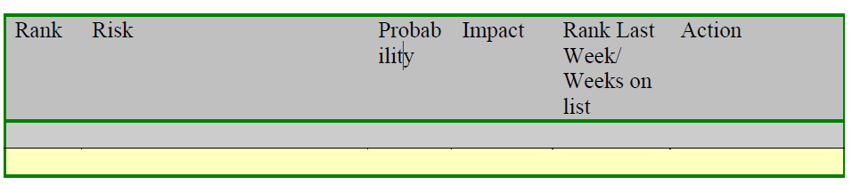
Risk Table Template

Slide 28
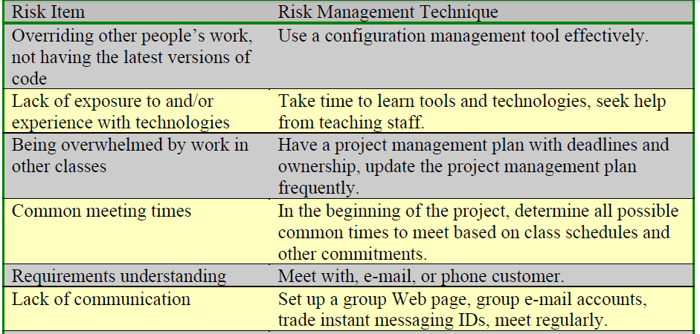
Risk Management in Educational Projects
Student Top 10 Risk Items

Slide 29
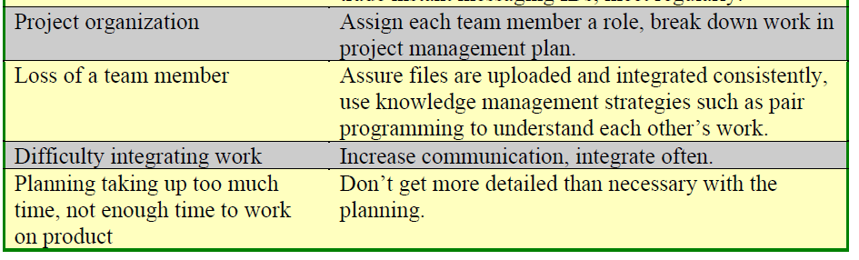

Slide 30
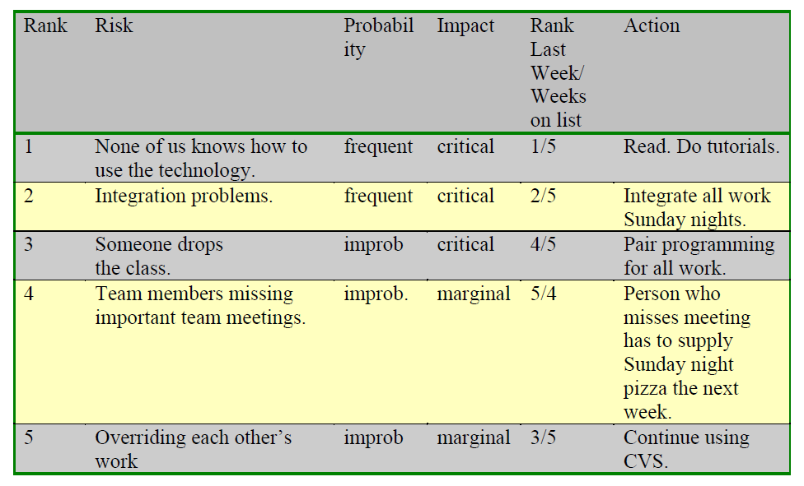
Sample Student Risk Table

Slide 31
THANK YOU

